Slide 1
Nitrous Oxide
Education Partnership Team
Notes:
Introductions/Welcome
1-2 mins

Slide 2
Today’s Session
Build an understanding of Nitrous Oxide
Identify the health impacts of the use of Nitrous Oxide
Identify current legislation in relation to possessing/selling of Nitrous Oxide
Notes:
Outline objectives
Gather an understanding of knowledge within the group
3 mins

Slide 3
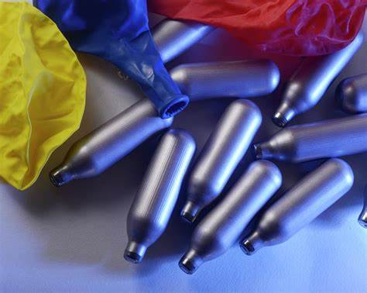
What is Nitrous Oxide?
It is a colourless gas sold in canisters, usually inhaled using a balloon.
Notes:
SLIDE PURPOSE
Visual
SLIDE OBJECTIVE
Increase knowledge of how NOS is used

Slide 4
What is Nitrous Oxide?
NOZ/NOS HIPPY CRACK
LAUGHING GAS
BALLOONS CHARGERS
WHIPPETS
Notes:
SLIDE PURPOSE
Group discussion
SLIDE OBJECTIVE
To raise awareness of alternative names for Nitrous Oxide.
Approx 5 mins

Slide 5
Media Reporting
Consider
‘Role of Social Media’
‘Peer Pressure’
‘How much knowledge and understanding did the young person have prior to using Nitrous Oxide’
Notes:
SLIDE OBJECTIVE
Group discussion from video content
Focus on group steered towards 3 key areas to maintain engagement.
Role of Social Media: This can be glamorisation of NOS, platform for buying & selling.
Peer Pressure: Again consider discussion around use of social media ‘The next TIK-TOK’ craze’.
How much knowledge did the young person have prior to using NOS: Aware of the risks?, where did she get her information from? This can potential refer back to peer pressure/social media.
Video: 3 mins
Discussion: 10 mins
Video Link: https://youtu.be/AHS4kaIB_5s

Slide 6
Activity: The Risk
Using post it notes, can you come up with some of the risks to using Nitrous Oxide?
Consider short and long term health impacts
Consider impact to relationships
Consider impact to the
Environment
Notes:
Post it note activity:
Either on flip chart or directly on the board, create three columns:
Column 1: Impact on Health. Examples of falling unconscious, suffocation, dizziness, paralysis
Column 2: Impact on Relationship. Examples of relationships with family, friends etc
Column 3: Impact on Environment. ASB, littering, also consider school/college/work environments
Depending on size of group, consider paired or groups of three i.e. one column to each group
Give the group 5 mins to and get them to stick the post it note up under its associated category.
Outline activity: 5 mins
Activity: 5 mins
Group findings: 10-15 mins

Slide 7
Legislation: The Law!
POSSESION: There is currently NO penalty for possession …
HOWEVER SUPPLY…….
As of 2016, Nitrous Oxide is covered by the Psychoactive Substances Act and is illegal to supply for its psychoactive effect.
Supply and production can get you up to 7 years in prison, an unlimited fine or both
Notes:
SLIDE PURPOSE
Group discussion
SLIDE OBJECTIVE
Legislation awareness
Approx 5 mins

Slide 8
Reporting & Support
If you have a concern your own or another persons safety, please approach a member of staff or to the Safeguarding Team in your School or College
In addition to your GP, there are may helpful websites that offer support for Physical & Mental Health such as:
Help & Advice - FRANK - Honest information about drugs | FRANK (talktofrank.com)
MIND Useful contacts - 11-18 year old's mental health – Mind
If you witness an incident of Nitrous Oxide use, and there is immediate risk of danger or risk to public safety (e.g. the event is escalating) Call 999
Non emergency report via 101 (e.g. information about an event that is not in progress)

