Slide 1
Notes:
Let’s start!

Slide 2
Notes:
Notes/Talking Points:
As you get older you will gradually be allowed to go to more places on your own or with friends, without an adult.
For example: the swimming pool, the skate park, or just walking to and from school.
This means you’ll be becoming more independent…Hooray!
Get the children to call out other places they might go without an adult. (Prompt: shopping centres, the cinema, the park and leisure centres.)
And, by the time you go off to secondary school you may even have taken bus, train or tube journeys by yourselves.
Where’s the one other place you already spend time?..some probably too much time!... ONLINE.
On social media, apps, websites and computer games.
All of these outdoor and online places have rules, don’t they? What are some of the rules?
· Outside: No littering, road safety rules, no cycling
· Transport: No feet on seats, no hot food, buy a ticket
· Inside: No smoking, no skateboarding
· Online: Don’t share personal info, don’t buy things without permission
But, there’s one very important rule you must learn so you can safely enjoy your independence in all of these places.

Slide 3
Notes:
Notes/Talking Points:
The Clever Never Goes rule:
If anyone asks you to go
Even someone that you know
If it hasn’t been agreed, remember:
CLEVER NEVER GOES
Whether you’re out and about or playing online the same rule applies.
· Ask the children what they think this rule means
· What does ‘hasn’t been agreed’ mean?
· Can they give examples of when someone/anyone might ask them to go somewhere with them?
Look out for discussion about ‘strangers’ (likely to be mentioned by children). Ask if they think all strangers are dangerous (and answer that most people will help children).
This rule isn’t just about strangers. It’s about not going with anyone when it hasn’t been agreed in advance. Who could that be? (Prompt: neighbour, family friend, school friend etc.)

Slide 4
Notes:
Notes/Talking Points:
In this lesson we talk about OK and NOT OK situations, and we use our little emoji guys to show which is which.
Most of the time – when you’re outside or online – the situation is OK; no-one asks you to go anywhere with them. We show this as a green emoji.
Later on, when we go through some scenarios you’ll be asked if a situation is OK or NOT OK and you’ll need to think about it – here we use a yellow emoji.
But, if anyone tries to get you to break the Clever Never Goes rule, this situation is NOT OK. And we show a red emoji.
Remember the rule? If anyone asks you to go – even someone you know – if it hasn’t been agreed with a parent or carer first, then it’s NOT OK. And…Clever Never Goes!
Ask the children if they can think of a reason why it’s NOT OK to go with someone even that they know (when it hasn’t been agreed beforehand). Prompts:
It could be unsafe – they might want to harm you
Your parents/carers will want to know where you are – they’ll worry if you go somewhere without telling them.
(For example, you’re walking home with your best friend when they suddenly invite you home to see their new cat.
It’s not unsafe but you should always agree it with your parents/cares first.)
Right, let’s put what we’ve learnt into practise…

Slide 5
Notes:
The aim of the game is to get you to recognise when anyone is asking you to go somewhere, and whether you can determine if a situation is OK or NOT OK – and what you can do.
First, print out a set of emojis (found on pages 25 – 27) and place them in individual spaces at the front of the classroom.
How to play:
First read out scene A (and show the illustration on screen). Explain why this is a green/OK situation – so far no one has been asked to break the Clever Never Goes rule.
Click to the next slide and read scene B. Ask the children to have a think to themselves is this OK or NOT OK? (Or you could get them to talk it through with a partner.)
Next, ask them to walk to the emoji they think is correct: is it green (OK), or red (NOT OK), or if they are unsure and need to keep thinking choose yellow…“GO!”
Now, they have one final chance to make up their mind and change emojis if they want… “GO!”
Remember:
Green = OK – no one has been asked to break the rule
Yellow = Not sure OR thinking about it
Red = NOT OK – someone has asked them to go somewhere when it hasn’t been agreed in advance
If the answer is NOT OK, use these notes to discuss what has just happened and what action they could take if they find themselves in that situation.
Let’s play a practice round first.
ALTERNATIVELY, instead of asking the children to walk to the emoji, you could give each child a set of emojis (see slide 28), cut them into individual faces, and ask them to hold up the one they think is correct.

Slide 6
Notes:
Scene A: Oliver is walking through a park when a man emerges from a nearby wooded area.

Slide 7
Notes:
Scene B: The man approaches him and says: “I’ve lost my phone in the woods, could you help me look for it please?” and gestures towards the wood. Oliver doesn’t recognise this man.
Ask the children to think to themselves (or discuss with a partner) is this situation OK or NOT OK?
Then, get them to walk to the emoji they think is correct… “GO!”
Now, give them a final chance to switch emojis if they want…“GO!”
Before revealing the answer on the next slide this is an opportunity to discuss the children’s choices.

Slide 8
Notes:
ANSWER: NOT OK
A person not known to Oliver asked him to go somewhere.

Slide 9
Notes:
WHAT TO DO AND SAY, WHEN IT’S NOT OK
Before revealing the response, ask the children what they’d do in that situation.
Response: Say “No” firmly and keep moving away from the person. Shout for help if you need to attract attention. Report the incident to a trusted adult.
Open up discussion around ‘disengaging strategies’, such as: “No, I need to be going” or “No, my Dad’s just around the corner.”

Slide 10
Notes:
Notes/Talking Points:
It's really important that you think about what you can do or say if you ever find yourselves in a NOT OK situation.
Here are some basic responses:
A firm, verbal response (NB different situations will require different verbal responses. The set of scenarios that follow provide lots of ideas about how children can disengage from a conversation.)
Attract attention if you need to – shout, call for help or make a loud noise
If in direct danger – run away
If invited by a friend but it hasn't been arranged – ask your parent/carer first
If something worrying ever happens then report it to a trusted adult - never feel silly, ashamed or embarrassed as being in a NOT OK or an unsafe situation is NEVER your fault
Go through with the children what is meant by a ‘trusted adult’ - get them to give you examples of who they might be.
Flight not fight - children often bring up (or act out) fighting as a response. It's important to point out that this is very much the last resort, and they should try using the other methods to disengage or get away before a situation gets to this point.
Let’s move onto the next scenario…

Slide 11
Notes:
Harry and Chloe are going to the shops by themselves to buy some bread and milk for their Mum.

Slide 12
Notes:
On the path the children pass their neighbour who’s putting his bins out. He asks them where they’re going.
THINK/TALK WITH PARTNER
WALK TO EMOJI…GO!
SWITCH IF YOU WANT…GO!
DISCUSS CHILDREN’S CHOICES

Slide 13
Notes:
ANSWER: OK
He’s not asking them to go anywhere. He is having a neighbourly conversation with them in the presence of their Mum.

Slide 14
Notes:
Mo is playing a game on his Xbox connected to the TV.

Slide 15
Notes:
He’s playing and exchanging messages with his best friend Sam: “What U doing this afternoon?”, “Nothing much, U?”, “Jamie’s coming over. We’re going to the park around 4, U coming?”
THINK/TALK WITH PARTNER
WALK TO EMOJI…GO!
SWITCH IF YOU WANT…GO!
DISCUSS CHILDREN’S CHOICES

Slide 16
Notes:
ANSWER: NOT OK
Although Mo knows it’s Sam, it hasn’t been agreed in advance by his parents.

Slide 17
Notes:
WHAT TO DO AND SAY, WHEN IT’S NOT OK
DISCUSS CHILDREN’S RESPONSES
Response: Whilst this is not an unsafe situation you should always check with your parents/carer before going somewhere, even if to meet trusted friends.

Slide 18
Notes:
Jo and Lily are waiting for their Mums who’ve gone into a shoe shop. Two boys approach them.

Slide 19
Notes:
One boy asks: “Hey, why don’t you come with us to the arcade?” One girl says to the other: “Let’s go, they’ll be ages yet.” They recognise the boys but don’t know them well.
THINK/TALK WITH PARTNER
WALK TO EMOJI…GO!
SWITCH IF YOU WANT…GO!
DISCUSS CHILDREN’S CHOICES

Slide 20
Notes:
ANSWER: NOT OK
They don’t know the boys well and they’ve asked them to go with them when it hasn’t been agreed in advance.

Slide 21
Notes:
WHAT TO DO AND SAY, WHEN IT’S NOT OK
DISCUSS CHILDREN’S RESPONSES
Response: Stay where they are and just say: “No” or go into the shop and meet back up with their parents. Opportunity to open up the discussion around peer pressure.

Slide 22
Notes:
Vanessa is in her bedroom messaging her best friend, Chrystal, on social media.

Slide 23
Notes:
Chrystal sends Vanessa a link to a site where owners post photos of their pets, and encourages her to share pictures of her own dog.
THINK/TALK WITH PARTNER
WALK TO EMOJI…GO!
SWITCH IF YOU WANT…GO!
DISCUSS CHILDREN’S CHOICES

Slide 24
Notes:
ANSWER: OK
Vanessa is not being asked to go anywhere.
Need to remind children not to share personal information without asking a trusted adult first.

Slide 25
Notes:
Notes/Talking Points:
If you are finishing the session here then use this slide to recap what you’ve learnt. But, if you are continuing with more scenarios then skip this slide for now.
Who can remember the rule?
If anyone asks you to go
Even someone that you know
If it hasn’t been agreed, remember
CLEVER NEVER GOES
What does OK and NOT OK mean?
OK! - no one has asked you to break the CLEVER NEVER GOES rule
NOT OK! – someone (anyone) has asked you to break the rule
If you want to go and meet someone get permission from your parent/guardian first AND speak to them if you have any worries or questions.
If something has happened to you – outside or online – report it to a trusted adult.
Disengaging strategies – what to do and say when it’s NOT OK
Always remember: if something doesn’t feel right or if someone hurts you or makes you feel upset, IT’S NOT YOUR FAULT

Slide 26
Notes:
It’s after school, children are leaving through the gates, with lots of teachers, pupils and parents around.

Slide 27
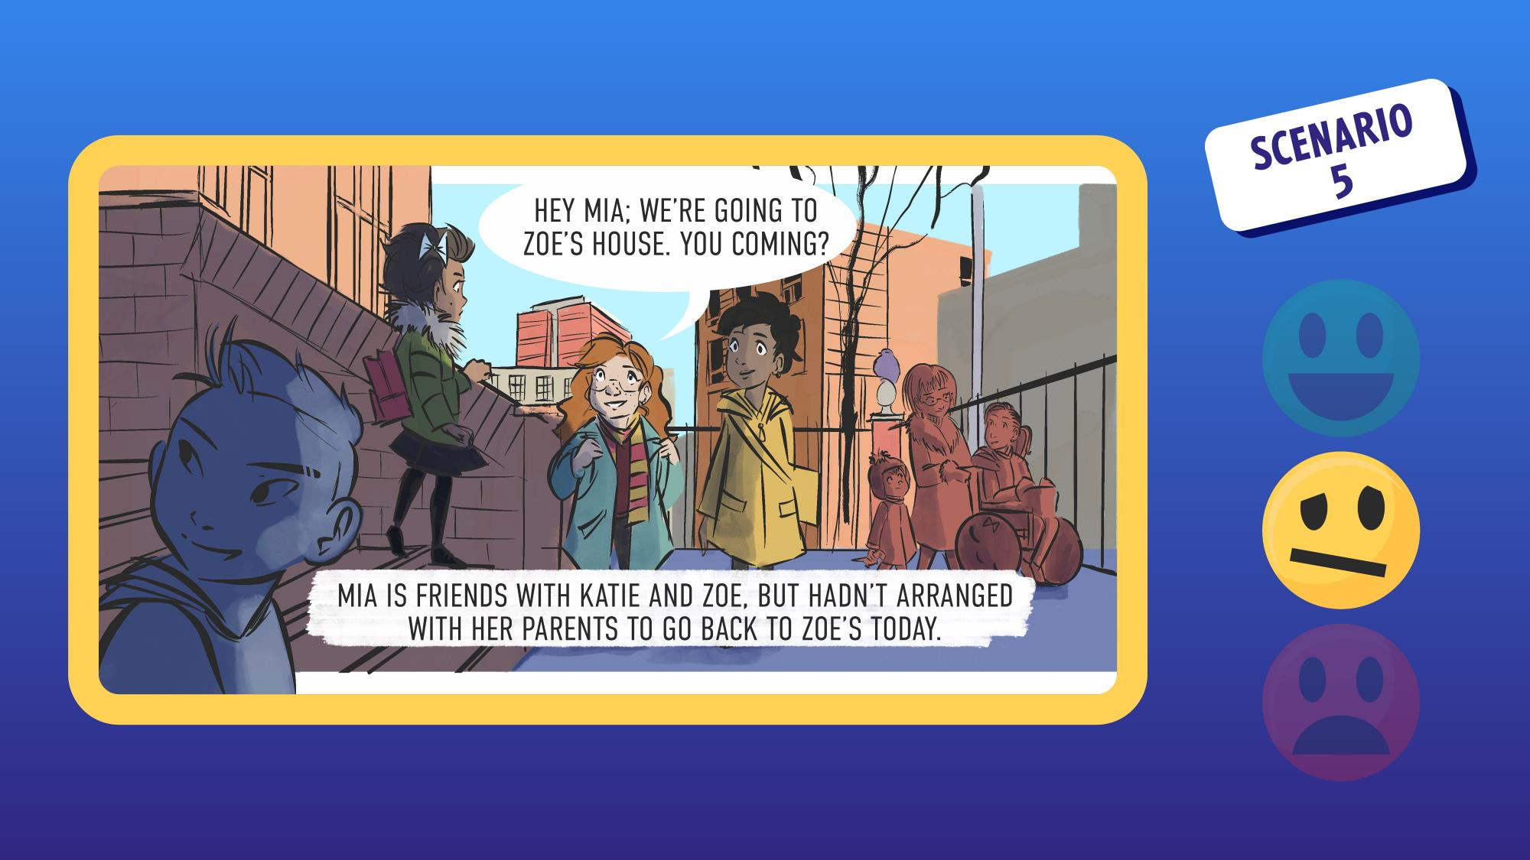
Notes:
One schoolgirl is approached by two others of the same age. One girl says: “Hey Mia, we’re going to Zoe’s house, you coming?”
Mia is friends with Zoe and Katie, but hasn’t arranged with her parents to go back to Zoe’s today.
THINK/TALK WITH PARTNER
WALK TO EMOJI…GO!
SWITCH IF YOU WANT…GO!
DISCUSS CHILDREN’S CHOICES

Slide 28
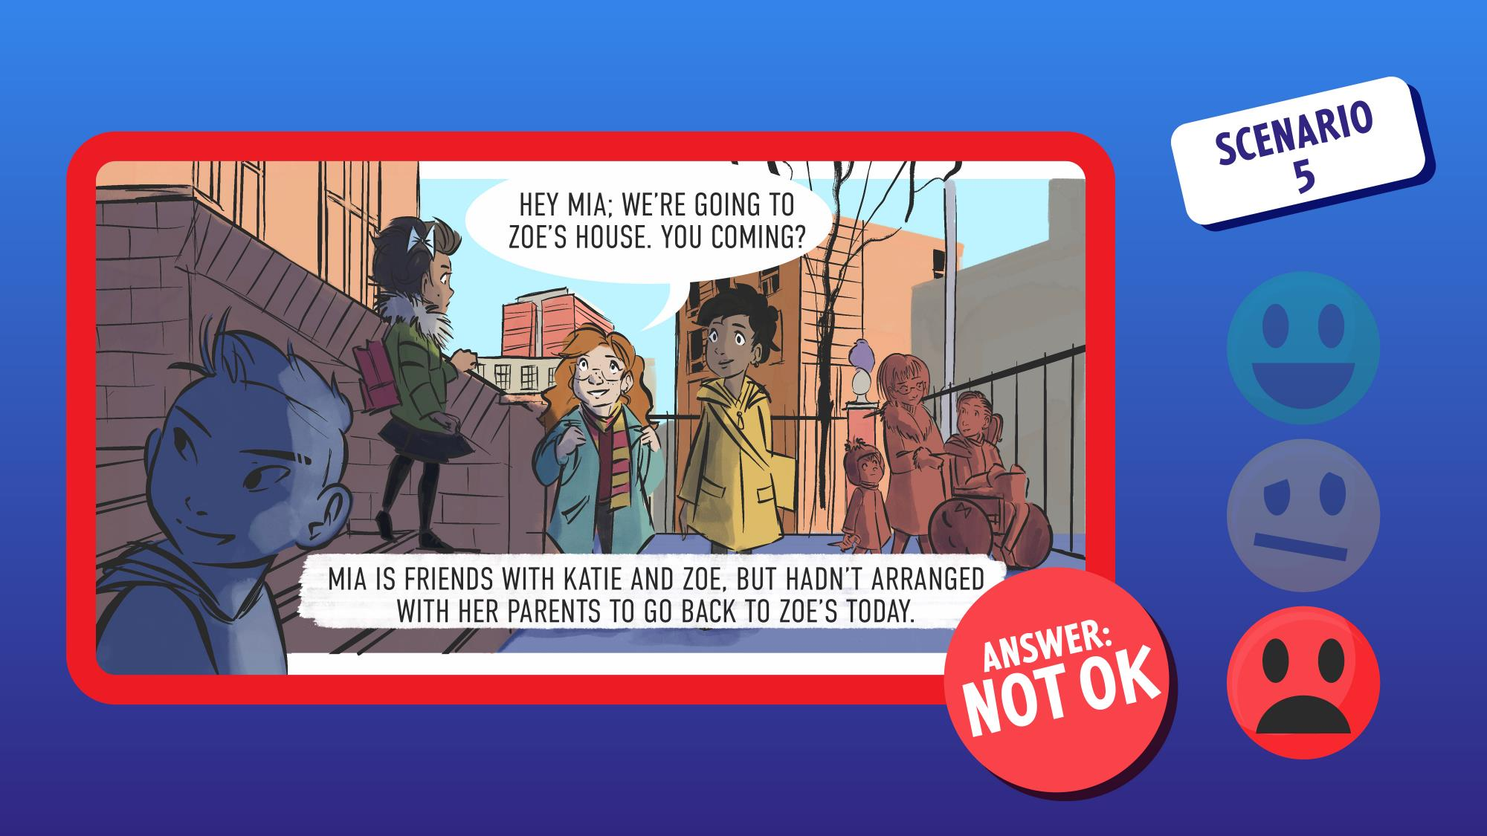
Notes:
ANSWER: NOT OK
Even though Mia knows the girls well, it hasn’t been agreed in advance by her parents.

Slide 29
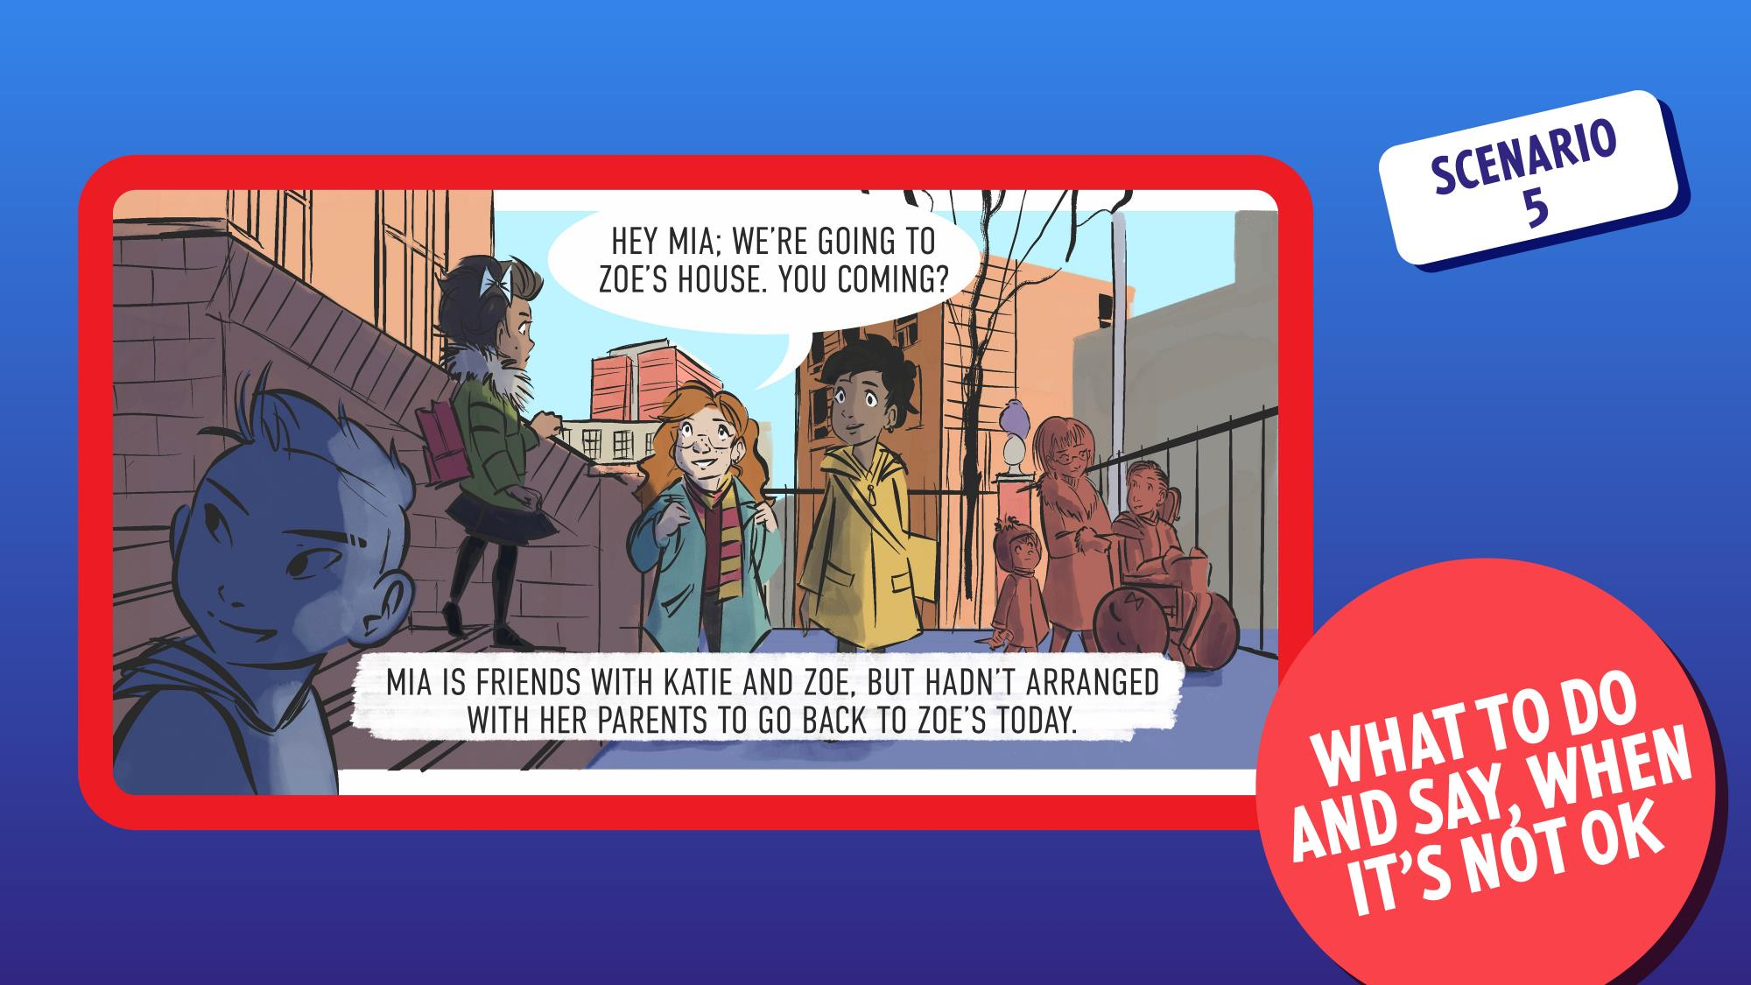
Notes:
WHAT TO DO AND SAY, WHEN IT’S NOT OK
DISCUSS CHILDREN’S RESPONSES
Response: Whilst this is not an unsafe situation, Mia should still tell them that she needs to ask her parents first - she could phone them up or perhaps go home first to check.

Slide 30
Notes:
A boy is walking along a busy street and a car approaches.

Slide 31
Notes:
A man in the car leans out of the window and asks: “Do you know where Portland Street is please?” Nathan doesn’t know this man in the car.
THINK/TALK WITH PARTNER
WALK TO EMOJI…GO!
SWITCH IF YOU WANT…GO!
DISCUSS CHILDREN’S CHOICES

Slide 32
Notes:
ANSWER: OK
He’s not asked the boy to go with him.
BUT, advice is to be cautious - don’t get too close to the car or engage in an ongoing conversation, make sure there are other people around who could help if needed.

Slide 33
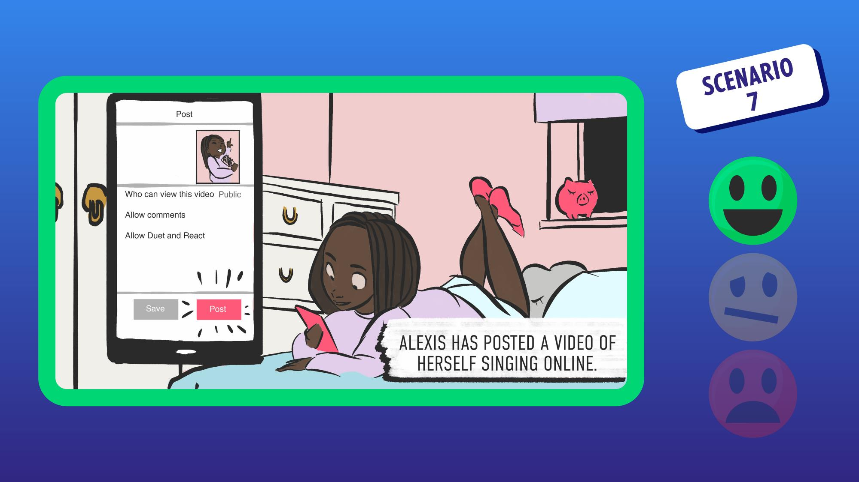
Notes:
Alexis is in her room on social media. Alexis has posted a video of herself singing online.

Slide 34
Notes:
Alexis receives a message from one young guy who really likes her singing. It reads: “That’s amazing. Great voice. Do you want to meet up and we can record you properly?”
THINK/TALK WITH PARTNER
WALK TO EMOJI…GO!
SWITCH IF YOU WANT…GO!
DISCUSS CHILDREN’S CHOICES

Slide 35
Notes:
ANSWER: NOT OK
Someone she doesn’t know (or even spoken to before) has asked her to meet up.

Slide 36
Notes:
WHAT TO DO AND SAY, WHEN IT’S NOT OK
DISCUSS CHILDREN’S RESPONSES
Response: The same CLEVER NEVER GOES rule applies online as it does outside. Never go with anyone you don’t know and report it to a trusted adult.
Opportunity to discuss online safety.

Slide 37
Notes:
A man and woman are talking to a girl on a bus. The girl says: “Hello Mrs Mitchell”.
The woman replies: “Hi Aisha, we haven’t seen you in ages. Sarah would love to catch up with you.”
Aisha has bumped into Mr & Mrs Mitchell on the bus home from school. She used to go to school with their daughter Sarah.

Slide 38
Notes:
The woman asks: “Why don’t you come home with us? I’ll call your Mum and she can pick you up later.”
THINK/TALK WITH PARTNER
WALK TO EMOJI…GO!
SWITCH IF YOU WANT…GO!
DISCUSS CHILDREN’S CHOICES

Slide 39
Notes:
ANSWER: NOT OK
Although the man and woman are known to the girl they asked her to go with them when a play date hasn’t been arranged.

Slide 40
Notes:
WHAT TO DO AND SAY, WHEN IT’S NOT OK
DISCUSS CHILDREN’S RESPONSES
Response: Aisha should call her parents and check first - if she has a phone - or politely decline and arrange another time to visit.
Opportunity to revisit disengaging strategy, based on knowing people.

Slide 41
Notes:
A girl and a boy are patting a dog in a park when its owner approaches.

Slide 42
Notes:
The boy asks: “What’s his name?” The girl says: “He’s so cute”. The man replies: “He’s called Terry. Would you like to throw a ball for him?” Noel and Jessica don’t know this man.
THINK/TALK WITH PARTNER
WALK TO EMOJI…GO!
SWITCH IF YOU WANT…GO!
DISCUSS CHILDREN’S CHOICES

Slide 43
Notes:
ANSWER: OK
He’s not asking them to go with him.
BUT, advice is to stay alert in case he does ask you to go with him.

Slide 44
Notes:
Jayden, is walking along a street full of shops and people when a car approaches.

Slide 45
Notes:
A woman gets out of the car and tells him: “You need to come with me. Your Dad sent me to pick you up and take you home.” Jayden doesn’t recognise this woman.
THINK/TALK WITH PARTNER
WALK TO EMOJI…GO!
SWITCH IF YOU WANT…GO!
DISCUSS CHILDREN’S CHOICES

Slide 46
Notes:
ANSWER: NOT OK
A person unknown to the boy, came towards him and asked him to go somewhere.

Slide 47
Notes:
WHAT TO DO AND SAY, WHEN IT’S NOT OK
DISCUSS CHILDREN’S RESPONSES
Response: Move away quickly and firmly say: “No.” And report the incident to a trusted adult.
Open up discussion about what else he could do, e.g. if he has a phone and it’s safe he could call his Dad. Or, go into a shop and ask for help.

Slide 48
Notes:
Amelia is on a live video meeting for her school work. Lots of her friends are also on the meeting, learning about the Roman Empire.

Slide 49
Notes:
Amelia receives a message from her school friend Harrison which says, “Hi Amelia can you send me the link to the YouTube video you found which explains this please?”
THINK/TALK WITH PARTNER
WALK TO EMOJI…GO!
SWITCH IF YOU WANT…GO!
DISCUSS CHILDREN’S CHOICES

Slide 50
Notes:
ANSWER: OK
Amelia has not been asked to go anywhere, nor has she been asked to reveal any personal data.

Slide 51
Notes:
Jodie is waiting at a bus stop when an 18 year old man approaches and says: “Hey, you’re Nick’s little sister aren’t you?”

Slide 52
Notes:
She replies: “Yeah.” The man says: “Don’t wait around for the bus. I’ll give you a lift. Come on.” Jodie recognises the man as a friend of her older brother but doesn’t know him well.
THINK/TALK WITH PARTNER
WALK TO EMOJI…GO!
SWITCH IF YOU WANT…GO!
DISCUSS CHILDREN’S CHOICES

Slide 53
Notes:
ANSWER: NOT OK
The man is only slightly known to Jodie and he’s asked her to go with him when this hasn’t been agreed.

Slide 54
Notes:
WHAT TO DO AND SAY, WHEN IT’S NOT OK
DISCUSS CHILDREN’S RESPONSES
Response: Just say “No” or other disengaging strategies, e.g. “It’s OK I’m meeting my friend/Mum/Dad on the bus.”
Also check to see if there are other people who could help if needed.

Slide 55
Notes:
Notes/Talking Points:
Finish off the lesson with a recap on all the key messages and learnings.
The rule:
If anyone asks you to go
Even someone that you know
If it hasn’t been agreed, remember
CLEVER NEVER GOES
What does OK and NOT OK mean?
OK! - no one has asked you to break the CLEVER NEVER GOES rule
NOT OK! – someone (anyone) has asked you to break the rule
If you want to go and meet someone get permission from your parent/guardian first AND speak to them if you have any worries or questions.
If something has happened to you – outside or online – report it to a trusted adult.
Disengaging strategies – what to do and say when it’s NOT OK
Always remember: if something doesn’t feel right or if someone hurts you or makes you feel upset, IT’S NOT YOUR FAULT.

