Slide 1
Ensure you read the guidance before teaching the lesson
Teacher
slide
Drug and alcohol education
KS3
Year 7/8 Lesson 2:
Tobacco – risks and influences

Slide 2
Teacher
slide
Using this PowerPoint
The slides in this presentation are divided into two sections:
Teacher slides (purple) – provide key information regarding lesson preparation
Pupil slides (white) – provide a visual focus point for pupils during the lesson and delivery notes for teachers about the activities. Click ‘notes’ to view these.
Ensure that you select ‘Use Presenter View’ under the ‘Slide Show’ tab – this will allow you to preview the teaching notes on your monitor while the main presentation is displayed on a screen/smartboard.
© PSHE Association 2020

Slide 3
Challenge and support
Teacher
slide
The lesson includes suggestions for challenge and support activities, to help you differentiate appropriately for your class.
Challenge activities deepen and extend the learning for those who need more challenge or who finish the activity quickly.
Support activities are adapted to be more accessible for those who need it.
Look for the logo on the pupil slides. See delivery notes for details of the activities.
Support
Challenge
© PSHE Association 2020

Slide 4
Context
Teacher
slide
This is the second of three lessons for lower key stage 3, providing age-appropriate knowledge about substance use and the understanding and skills to manage influences young people experience in relation to tobacco, alcohol and other drugs. This lesson focuses on specific risks relating to tobacco and nicotine product use and strategies to manage influences regarding use of these substances.
Neither this, nor any of the other lessons, is designed to be taught in isolation, but should always form part of a planned, developmental PSHE education programme.
© PSHE Association 2020

Slide 5
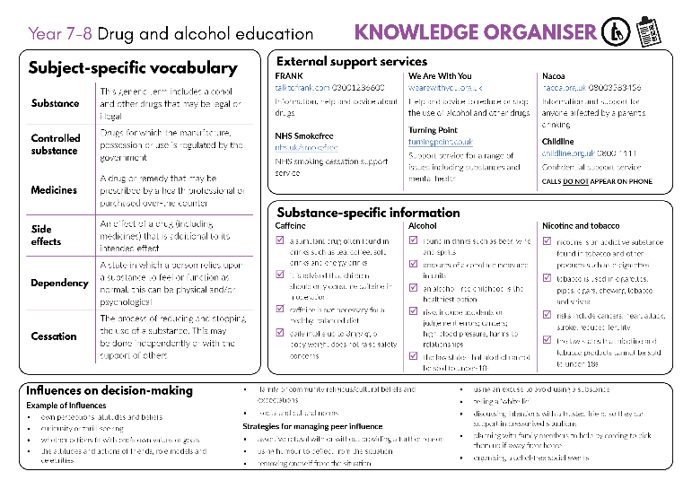
Developing subject knowledge
Teacher
slide
Key information on content related to these lessons can be found in the Year 7-8 Knowledge Organiser.
Advice on safe practice, dispelling common misconceptions, visitors to the classroom and other important information can be found in Teacher Guidance: Drug and alcohol education
Data sources to inform your planning can be found within our document that outlines the approach of these lessons Evidence Review: Effective drug and alcohol education, along with advice regarding how to talk to young people about addiction, dependency and problematic substance use.
© PSHE Association 2020

Slide 6
Teacher
slide
Learning objective
To understand and manage influences relating to tobacco and nicotine product use
Learning outcomes
Students will be able to:
identify a range of risks related to tobacco and e-cigarette use
analyse a range of potential influences on young people to smoke
demonstrate strategies for managing peer influence in situations involving tobacco and e-cigarettes/vapes
© PSHE Association 2020

Slide 7
Teacher
slide
Preparing to teach
Climate for learning
Make sure you have read the accompanying teacher guidance notes before teaching this lesson for guidance on establishing ground rules, the limits of confidentiality, communication and handling questions effectively.
Resources required
Box or envelope for anonymous questions
Post-it notes
Resource 1: Attitude continuum [1 per student]
Resource 2: Effects of using tobacco card sort [1 cut up set per pair]
Resource 2a: Effects of using tobacco card sort – answers [1 per class]
Resource 3: Spotting influences statements [1 per student]
Resource 3a: Spotting influences statements – support sheet [1 per student requiring support]
Duration
This has been designed to be taught as a sixty minute PSHE education lesson
Further guidance
Members of the PSHE Association can access our website for further guidance www.pshe-association.org.uk
60
© PSHE Association 2020

Slide 8
Teacher
slide
Lesson summary
Activity | Description | Timing
Introduction | Introduce learning objectives and outcomes and reinforce ground rules | 5 MINS
2. Values reflection | Students place statements on attitudes and values relating to tobacco, alcohol and other drugs on an attitude continuum. Feedback using social norms statistics quiz. | 15 MINS
3. Tobacco effects | Students sort cards into physical, mental and social/legal effects of using tobacco. | 10 MINS
4. Spotting influences | Students identify the potential influences on young people’s decisions about smoking. | 10 MINS
5. Managing peer influence | Students provide a range of strategies to manage peer influence | 10 MINS
6. Endpoint assessment | Students identify what they have learnt in the lesson using their hand as a template. | 5 MINS
7. Signpost support | Signpost to further guidance and support related to tobacco, alcohol and other drugs. Respond to anonymous questions. | 5 MINS
© PSHE Association 2020

Slide 9
Lesson 2:
Tobacco – risks and influences

Slide 10
Ground rules
[Add your class rules here]
Notes:
Teacher Notes
Negotiate or revisit ground rules for the lesson. Use this slide to display your class agreement / ground rules for PSHE education lessons. See Accompanying Teacher Guidance (separate document).

Slide 11
We are learning to understand and manage influences relating to tobacco and nicotine product use
We will be able to:
identify a range of risks related to tobacco and e-cigarette use
analyse a range of potential influences on young people to smoke
demonstrate strategies for managing peer influence in situations involving tobacco and e-cigarettes/vapes
Notes:
Teacher Notes – Learning objective and outcomes
Introduce the learning objective and outcomes and explain that today’s lesson focuses on specific risks relating to tobacco and nicotine product use and strategies to manage influences regarding use of these substances.

Slide 12
Values reflection
Cut out the statements and place each where you think it falls on the continuum.
STRONGLY AGREE
STRONGLY DISAGREE
1. People overstate the risks of using alcohol and tobacco | 2. When people take drugs, they never really know what they are taking | 3. Medications have been well evaluated so there are no risks when taking them
4. It is important for people to make their own mind up about taking substances | 5. Making healthy choices regarding drugs, alcohol and tobacco is easy | 6. Young people like taking risks and find smoking and drinking exciting
7. Young people mostly use drugs because their friends do | 8. If adults didn’t drink or smoke as much, young people wouldn’t either | 9. Fewer school children are using drugs, alcohol and tobacco
Notes:
Teacher Notes – Values reflection (15 mins)
Hand out Resource 1: Attitude continuum, ask students to cut out each statement and the continuum and place the statements on the continuum. (Alternatively, students could draw the continuum in their books and write the statements along it.)
Take feedback, ensuring the following key points are covered:
A range of influences impact on substance use decisions – parents/family, other adults, peers, the media, industry and advertising, perceptions of public opinion. It is important to think about what we value most. Good health, positive relationships, fun and future aspirations are key considerations for many people but what those look like and the order of priority will be different for each person.
Medications are well researched but still carry risks – hence medical supervision is required for prescribed drugs, and over-the-counter drugs carry specific instructions on use which must be followed. Each person must make a decision based on their own health, values and understanding of the substance in question.
The data on illicit use of tobacco, alcohol and other drugs, shows use among young people is declining. To explore this further, ask students to write down their answers to the social norms quiz below, which uses data from the Smoking, Drinking and Drug Use Survey in England (SDDU) 2018. Go through the correct percentages after all the questions have been answered, rather than after each one, so that they do not influence students’ subsequent answers.

Slide 13
Values reflection
Write down what you think the answers might be to the questions below:
What percentage of young people aged 11-13 have never tried smoking cigarettes?
What percentage of young people aged 11-13 say they are regular smokers?
What percentage of young people aged 11-13 are regular users of e-cigarettes/vapes?
What percentage of young people aged 11-13 said they had never taken drugs?
92%
0.4%
1%
85%
Notes:
Then, ask students to write down their answers to the social norms quiz, which uses data from the Smoking, Drinking and Drug Use Survey in England (SDDU) 2018. Go through the correct percentages after all the questions have been answered, rather than after each one, so that they do not influence students’ subsequent answers.
1. What percentage of young people aged 11-13 have never tried smoking cigarettes? [92%]
2. What percentage of young people aged 11-13 say they are regular smokers? [0.4% - so 99.6% are not]
3. What percentage of young people aged 11-13 are regular users of e-cigarettes/vapes? [1% - so 99% are not]
4. What percentage of young people aged 11-13 said they had never taken drugs? [85%]
Students often overestimate their peers’ engagement in unhealthy behaviours due to media messaging, interactions with only a small section of society which skews perceptions, and some young people claiming to have participated when they haven’t. Correcting this perception of their peers’ behaviour supports students to resist internal pressure to ‘fit in’. Refer to the evidence briefing paper for further guidance about using positive social norms with care.
All percentages calculated as a weighted average to account for SDD methodology (larger cohort sizes in older age groups.)

Slide 14
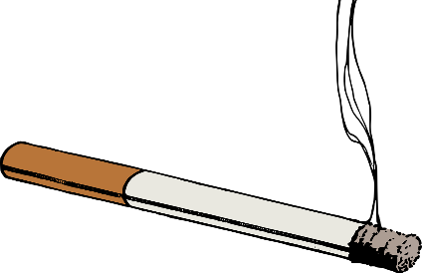
Tobacco effects
Are there any risks that could fall under more than one category?
Are there any short-term risks that may lead to other longer-term risks?
Why do you think tobacco has a legally imposed age restriction?
Why do you think the number of young people who smoke cigarettes has decreased year on year for the last 30 years?
What is the difference between nicotine and tobacco?
In pairs, categorise the risks into physical, mental/emotional and social/legal effects of using tobacco. e.g.:
Notes:
Teacher Notes – Tobacco effects (10 mins)
Ask students to discuss, then feedback what they think the difference is between nicotine and tobacco.
Explain that nicotine is an addictive stimulant found in tobacco and other products such as e-cigarettes/ vapes and nicotine replacement products such as patches and gum. Tobacco is a plant grown for its leaves and is used in cigarettes, pipes, cigars, chewing tobacco and shisha. When tobacco is manufactured for cigarettes, other substances are added to enhance the addictive properties of nicotine. While nicotine gets people hooked on cigarettes, it’s the thousands of other chemicals in tobacco smoke, including tar and carbon monoxide, that cause almost all of the harm from smoking.
Hand out Resource 2: Risks of using tobacco card sort and ask students to work in pairs to categorise the risks into physical, mental/emotional and social/legal effects of using tobacco. Use Resource 2a: Risks of using tobacco card sort – answers to check answers.
Develop learning by asking students the following questions:
Are there any risks that could fall under more than one category?
Are there any short-term risks that may lead to other longer-term risks?
Why do you think tobacco has a legally imposed age restriction?
Why do you think the number of young people who smoke cigarettes has decreased year on year for the last 30 years?
Support:
Students who need additional support can be given fewer cards to sort. Ensure the cards are selected to provide a range of effects across the three headings.
Challenge:
Ask students to further sort the cards into short-term and long-term effects of tobacco use.

Slide 15
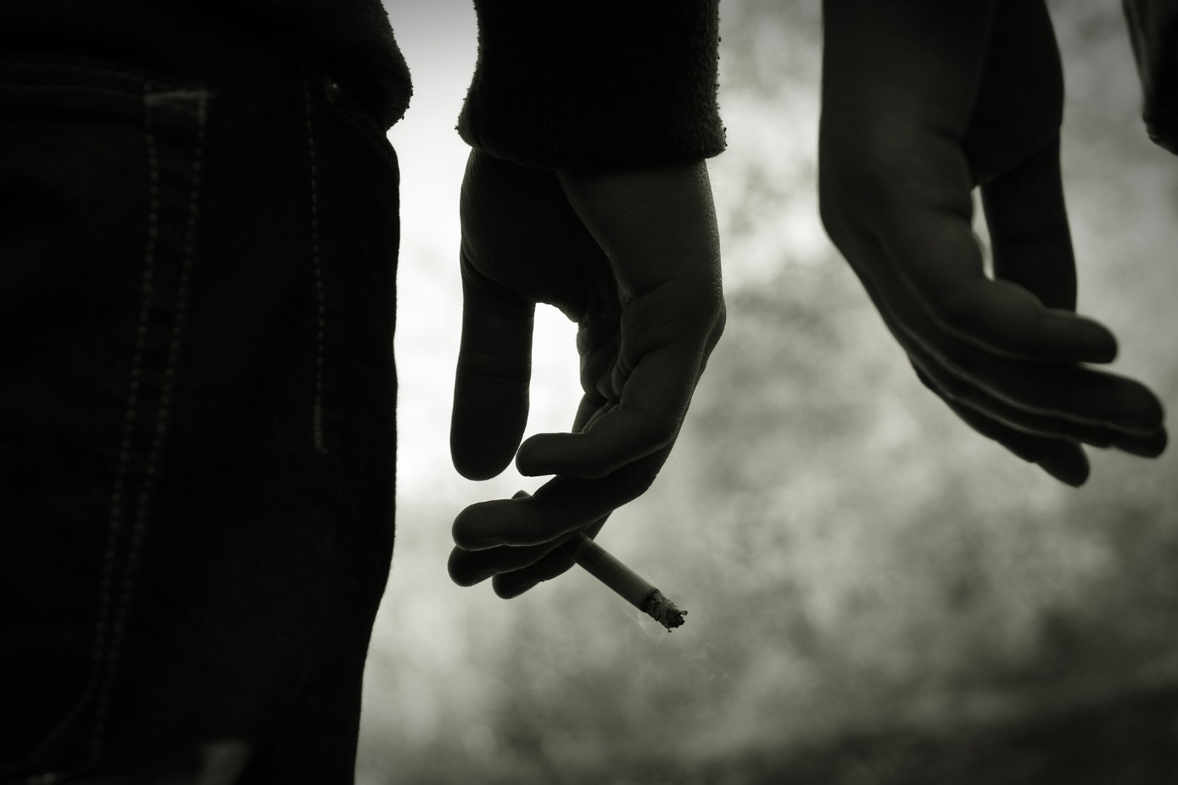
Spotting influences
Read through the statements and discuss the influences on each character.
Then annotate each statement with your ideas.
Notes:
Teacher Notes – Spotting influences (10 mins)
Individually, students read through and discuss the influences on each character in Resource 3: Spotting influences statements. Ask students to annotate each statement with their ideas about what influences are acting on the characters.
Take feedback, drawing out the following influences and key points:
1: Curiosity, perception that e-cigarettes are not/less harmful, or smoking being normalised at home are possible influences. Reinforce that e-cigarettes are a replacement source of nicotine for those who want to quit smoking. If a non-smoker starts using e-cigarettes that contain nicotine, they risk developing a nicotine addiction. Remind students it is illegal in the UK to sell e-cigarettes/vapes to someone under the age of 18.
2: Peers can have a strong influence, particularly when the rest of the group have chosen to smoke.
3: Looking up to an ‘older crowd’, feeling intimidated or being concerned with impressing others can influence rational decision-making.
4: Perceptions of what is culturally ‘normal’ and the desire to fit in with this and be included, and the ‘party atmosphere’ would be strong influences. Shisha smoking is not a safe alternative as it still exposes users to carbon monoxide and many other toxins. It is also important to mention it is illegal to allow the smoking of shisha pipes inside enclosed cafes/bars due to the health risks related to second-hand smoke.
5: Role models and the media can influence decision-making. While vaping is far less harmful than smoking, it is not risk free. Both can be addictive mostly due to the presence of nicotine and the ease of which it can be taken and become part of someone’s daily routine. Quitting therefore can be difficult, costly and require several attempts to be successful. There are a number of ways a person can get support to quit smoking and more information can be found at www.nhs.uk/smokefree.
Support: Hand students a copy of Resource 3a: Spotting influences statements – support sheet which provides a range of suggestions students can use to annotate each character’s statement.

Slide 16
Managing peer influence
Peer pressure - when people feel pressurised by their peers to do something that they might not want to do.
Peer influence - does not just refer to a peer pressurising someone to do something, but also includes internal pressures to fit in or do what the person thinks is expected in a situation.
Read the scenario you have been given:
What advice could you give about how the character could manage the influence?
How might the character in statement 2 say “no” in response to peer influence? Write down 3 quotes on your post-its.
Notes:
Teacher Notes – Managing peer influence (10 mins)
Remind the class that ‘peer pressure’ is when people feel pressurised by their peers to do something that they might not want to do. ‘Peer influence’ does not just refer to a peer pressurising someone to do something, but also includes internal pressures to fit in or do what the person thinks is expected in a situation. Is it important to acknowledge that peer influence is part of growing up, and we are influenced in many different areas, e.g. the teams we support, the music we like, or the clothes we buy – but this can extend to substance use behaviours as well.
Split the class into small groups and assign each group one of the scenarios taken from the ‘Spotting Influences’ activity. Ask students to give the character advice about how they could manage the influence. Collect some ideas from students.
Give each group three post-its and ask them to think carefully and creatively about how the character in statement 2 can say “no” in response to peer influence, using the strategies below (stress that it is always best to start with a polite, friendly but assertive ‘No thanks’). Students then write their three quotes on individual post-it notes:
Giving an honest, open reason for saying no
Using humour
Using an excuse or telling a ‘white lie’.
Students can choose to come up to the board (divided into three) and stick their suggestions into the relevant section of the board. Share some of the best suggestions.
If time allows, ask pupils to rehearse some responses.

Slide 17
What has been learnt?
Draw around your hand and write the following on each finger:
Thumb: Something from today’s lesson that helped you feel more confident.
Index finger: Describe a strategy you learned today that you could use in the future.
Middle Finger: An interesting fact you learned this lesson.
Third Finger: Reflection on whether and how your opinion on smoking has changed. (If not, why not?)
Little finger: One way you can support others to resist peer influence.
Notes:
Teacher Notes – End-point assessment (5 mins)
In their books, students draw around their hand and write the following on each finger:
Thumb: Something from today’s lesson that helped you feel more confident.
Index finger: Describe a strategy you learned today that you could use in the future.
Middle Finger: An interesting fact you learned this lesson.
Third Finger: Reflection on whether and how your opinion on smoking has changed. (If not, why not?)
Little finger: One way you can support others to resist peer influence.
As this is a personal reflection, tell students they do not need to share their responses with the rest of the class, although some may choose to share their thoughts.

Slide 18
Further support
Speak to a tutor, head of year or other trusted member of staff in the school
For accurate, reliable health information, visit www.nhs.uk/smokefree
Visit www.talktofrank.com
Contact Childline www.childline.org.uk 0800 1111
Notes:
Teacher Notes – Signposting support
Remind pupils who they can talk to if they are worried.

Slide 19
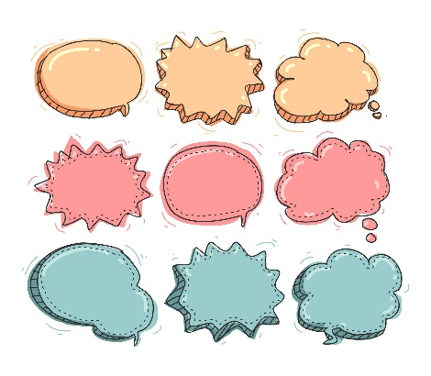
More activities
Create a storyboard about one of the characters from the ‘spotting influences’ statements showing why they felt influenced and how they managed it successfully.
You might wish to use thought bubbles and speech bubbles to show your ideas.
Notes:
Teacher Notes – Extension activities
Create a storyboard about one of the characters from the ‘Spotting influences’ statements showing why they felt influenced and how they managed it successfully. Students can be encouraged to use both thought bubbles and speech bubbles to show their ideas.

