Slide 1
Ensure you read the guidance before teaching the lesson
Teacher
slide
Drug and alcohol education
KS2
Year 5/6 Lesson 3
Managing risk: influences and pressure
© PSHE Association 2020

Slide 2
Using this PowerPoint
Teacher
slide
The slides in this presentation are divided into two sections:
Teacher slides (purple) – provide key information regarding lesson preparation
Pupil slides (white) – provide a visual focus point for pupils during the lesson and delivery notes for teachers about the activities. Click ‘notes’ to view these.
Ensure that you select ‘Use Presenter View’ under the ‘Slide Show’ tab – this will allow you to preview the teaching notes on your monitor while the main presentation is displayed on a screen/smartboard.
© PSHE Association 2020

Slide 3
Challenge and support
Teacher
slide
The lesson includes suggestions for challenge and support activities, to help you differentiate appropriately for your class.
Challenge activities deepen and extend the learning for those who need more challenge or who finish the activity quickly.
Support activities are adapted to be more accessible for those who need it.
Look for the logo on the pupil slides. See delivery notes for details of the activities.
Support
Challenge
© PSHE Association 2020

Slide 4
Context
Teacher
slide
This is the third of four lessons for upper key stage 2 pupils providing age-appropriate drug and alcohol education. This lesson focuses on the reasons why someone may or may not choose to use a drug, through analysing different influences. Pupils also explore ways to manage these influences and ways to respond, including how to do so assertively in a range of situations.
Neither this, nor any of the other lessons, is designed to be taught in isolation, but should always form part of a planned, developmental PSHE education programme.
© PSHE Association 2020

Slide 5
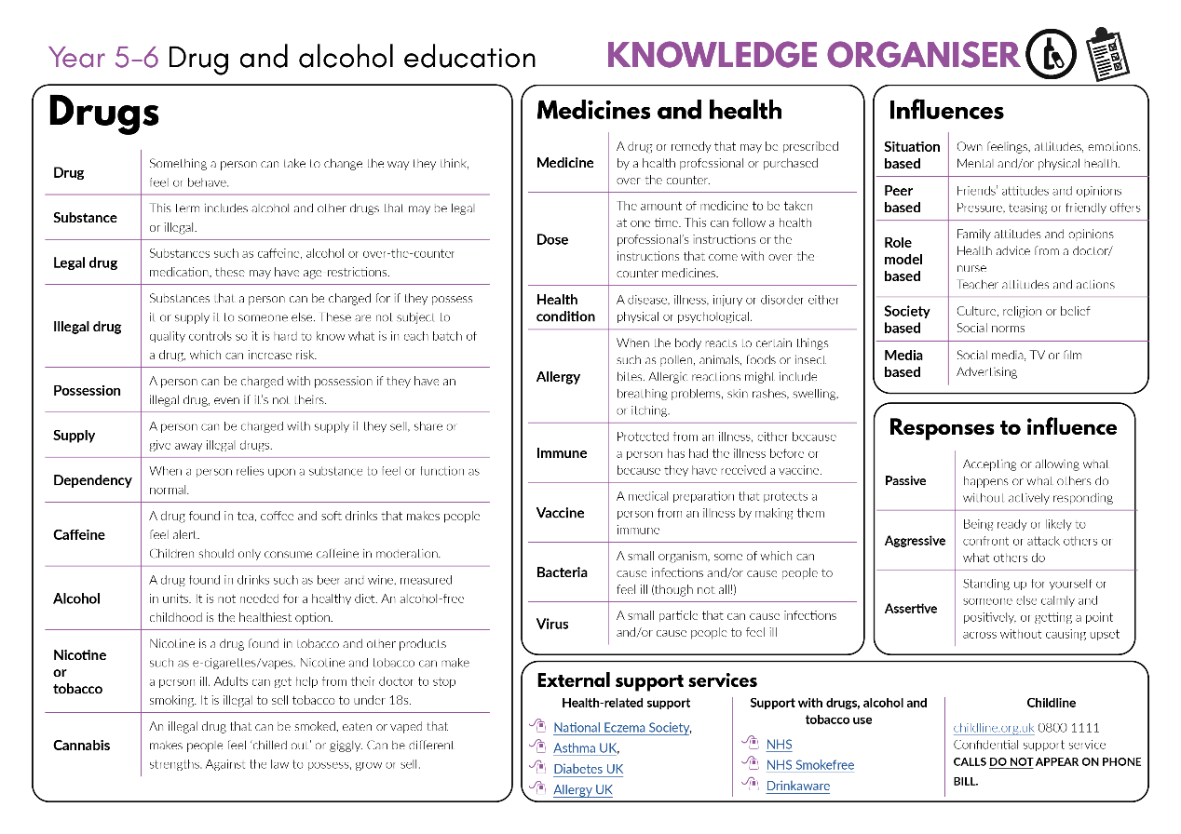
Developing subject knowledge
Teacher
slide
Key information on content related to these lessons can be found in the Year 5-6 Knowledge Organiser.
Advice on safe practice, dispelling common misconceptions, visitors to the classroom and other important information can be found in Teacher Guidance: Drug and alcohol education
Data sources to inform your planning can be found within our document that outlines the approach of these lessons Evidence Review: Effective drug and alcohol education, along with advice regarding how to talk to young people about addiction, dependency and problematic substance use.
© PSHE Association 2020

Slide 6
Teacher
slide
Learning objective
To learn about the reasons why people use drugs; managing situations and peer influence
Learning outcomes
Pupils will be able to:
explain why people may choose to use or not use a drug, and the different factors that might influence them
analyse what is most likely to influence a person to use or not use a drug
describe strategies for managing peer influence in situations that might involve drugs
explain how to ask for help from a trusted adult if they have any worries or concerns about drugs and why this is important

Slide 7
Teacher
slide
Preparing to teach
Climate for learning
Make sure you have read the accompanying teacher guidance notes before teaching this lesson for guidance on establishing ground rules, the limits of confidentiality, communication and handling questions effectively.
Resources required
Box or envelope for anonymous questions
Post-it/sticky notes
Resource 1: Bus stop conversation worksheet [1 per pupil]
Resource 2: Influences Diamond 9 cards [1 set per group]
Resource 3: Pressure scenario cards [1 set per class]
Resource 4: Responses prompts [1 per pair if needed]
Resource 4a: Responses prompts – teacher guide [1 copy for the teacher]
Duration
This has been designed to be taught as a sixty minute PSHE education lesson
Further guidance
Members of the PSHE Association can access our website for further guidance www.pshe-association.org.uk
60

Slide 8
Teacher
slide
Lesson summary
Activity | Description | Timing
1. Baseline assessment | To be completed before the lesson. Reinforce ground rules. Pupils complete speech and thought bubbles about smoking, alcohol or other drugs and why people use them | 10-15 MINS
2. Introduction | Remind pupils of ground rules and introduce the lesson. Pupils discuss reasons why someone may use a drug | 5 MINS
3. Influences diamond 9 – part 1 | Pupils discuss influences on a person’s decision to use a drug and rank different influences in a diamond 9 | 10 MINS
4. Influences diamond 9 – part 2 | Pupils discuss reasons why someone might choose not to use a drug, then repeat the diamond 9 activity but this time considering the influences not to use the drug | 10 MINS
5. Strategies for managing pressure | Pupils identify pressure in a scenario and explore what is meant by a passive, aggressive and assertive response | 10 MINS
6. Pressure scenarios | Pupils read scenarios and suggest ways the character can manage the influence or pressure in the situation, giving examples of an assertive response | 10 MINS
7. Signposting support | Signpost support for advice and what to do if they have concerns | 5 MINS
8. End-point assessment | Pupils write a ‘take-away’ sentence about their learning on drugs, alcohol and tobacco, pressure and how to manage it | 5-10 MINS
© PSHE Association 2020

Slide 9
Lesson 3
Managing risk: influences and pressure

Slide 10
Ground rules
[Add your class rules here]
Notes:
Teacher Notes
Use this slide to display your class agreement / ground rules for PSHE education lessons. See Accompanying Teacher Guidance.
Remind pupils of the importance of the shared ground rules for these lessons, including that it is important to accept that people have different opinions and beliefs and to be respectful of each other’s views in the lesson.

Slide 11
What’s our starting point?
Some young people are having a conversation about why people use drugs, smoke or drink alcohol.
What might they be saying?
What could someone do or say if they didn’t want to use drugs, smoke or drink alcohol?
Write your ideas on the worksheet.
Notes:
Teacher Notes – Baseline assessment (5-15 mins)
Pupils complete this activity before the lesson. This allows time to look through their work and note any particular patterns or misconceptions prior to teaching the lesson. Before carrying out the activity, remind pupils of ground rules for these lessons.
Pupils use Resource 1: Bus stop conversation worksheet to record their ideas. Collect these in and use responses to inform this lesson and future teaching about drugs, alcohol and tobacco.
Pupil responses might include:
They are saying: to try it out and see what it’s like, because they feel they need it, are addicted, because their friends are doing it, smoking is cool, to relax, vaping doesn’t harm you
If someone didn’t want to they could: say no; walk away; explain their reasons for not wanting to; avoid the situations or places where it happens.

Slide 12
We are learning about the reasons why people use drugs; managing situations and peer influence
We will be able to:
explain why people may choose to use or not use a drug, and the different factors that might influence them
analyse what is most likely to influence a person to use or not use a drug
describe strategies for managing peer influence in situations that might involve drugs
explain how to express worries about a person’s drug use and why this is important
Notes:
Teacher Notes – Learning objective and outcomes
Introduce the learning outcomes.

Slide 13
Drug use
Think of a drug.
?
Why might a person use that drug?
Notes:
Teacher Notes – Introduction (5 mins)
Ask pupils to think of a drug and why a person might use that drug. Record the pupils’ ideas on the board or flipchart.
Teacher’s note: To ensure a safe climate for learning is maintained, it is important that pupils know they do not need to name the drug or the person, just to give the reason.

Slide 14
Influences diamond 9
Most influence
Discuss the different people, places or things that might influence someone to use a drug.
1st
2nd
2nd
In your group, think of a drug and discuss what would most influence whether a person would use the drug. Then, use the diamond 9 to rank them from most to least influence.
3rd
3rd
3rd
4th
4th
5th
Least influence
Notes:
Teacher Notes – Influences diamond 9 part 1 (10 min)
Pupils discuss the different people, places or things that might influence someone to use a drug. Make a list on the board. Responses might include: where they are; who they are with; what they have seen/heard about the drug; their health; how they get the drug.
Pupils think of a drug and work in groups to consider what will most influence whether a person would use the drug. Ask pupils to rank the following influences from most to least influence in a diamond 9: friends; family; social media/TV/film; religion/beliefs; money; health advice (e.g. from a doctor); the situation; their feelings/emotions (mental health); their physical health – using Resource 2: Influences diamond 9 cards. The card at the top of the diamond should represent what they think is the greatest influence and the card at the bottom of the diamond should represent what they think is the least influence. The cards in the middle section are placed in rows that they think are ‘equally important’.
Compare responses from different groups. If there are any other influences that may not have been included on the cards that pupils discussed, highlight these with the class.
Support: Pupils work with a reduced number of influences in a diamond 5.
Challenge: Ask pupils to suggest another influence and add it to the blank card in Resource 2: Influences diamond 9 cards.

Slide 15
Influences diamond 9
Most important
Now, think about why someone might choose not to use a drug.
Thinking about the same drug, repeat the diamond 9 activity but this time rank what is mostly likely to influence someone not to use the drug.
Which examples are the most influential and why?
1st
2nd
2nd
3rd
3rd
3rd
4th
4th
5th
Least important
Notes:
Teacher Notes – Influences diamond 9 – part 2 (10 mins)
Now ask the pupils to consider reasons why someone might choose not to use a drug (any drug, including medicines).
Record their responses on the board, next to the original list of reasons why someone may use a drug. Note whether the pupils think the influences for or against using a drug are similar or very different.
Pupils repeat the diamond 9 activity, thinking about the same drug but this time considering what is most likely to influence someone not to use the drug. Take feedback, drawing out what happened to the diamond 9 cards and noting whether the cards change position or remain similar.
Pupil responses at the top of the diamond 9 might include:
• Their physical health or mental health - it is harmful to their body or mind
• Religion/beliefs - it is against their religion/beliefs
• Friends - their friends don’t use the drug so they don’t feel pressure to either
• Family - their family does not use the drug so they are not used to people using the drug
Pupils discuss which examples they think are the most influential and why.

Slide 16
Strategies for managing pressure
passive
aggressive
assertive
accepting or allowing what happens or what others do without actively responding.
being ready or likely to confront or attack others or what others do.
standing up for oneself or someone else, calmly and positively, or getting a point across without causing upset.
Notes:
Teacher Notes – strategies for managing peer pressure (10 mins)
Write the following words on the board: passive, aggressive, assertive and discuss what they mean. For example:
Passive: accepting or allowing what happens or what others do without actively responding
Aggressive: being ready or likely to confront or attack others or what others do
Assertive: standing up for oneself or someone else, calmly and positively, or getting a point across without causing upset
See next slide for Pressure scenario cards activity.

Slide 17
Strategies for managing pressure
Listen to the pressure scenario.
With your partner, discuss who or what the character is being influenced by and whether they are feeling pressure, including peer pressure.
Now, think about how the character could respond:
What would be an example of a passive response?
What would be an example of an aggressive response?
What would be an example of an assertive response?
Notes:
Teacher Notes – strategies for managing pressure
Display and read aloud one of the scenarios from Resource 3: Pressure scenario cards
Pupils work in pairs to identify who or what the character is being influenced by and whether they are feeling pressure, including peer pressure (pressure from those around them).
Pupils consider the different ways the character could respond:
What would be an example of a passive response?
Such as, joining in with the group to feel included
What would be an example of an aggressive response?
Such as, shouting no and being rude to others
What would be an example of an assertive response?
Such as, saying ‘no’ calmly and giving reasons why they don’t want to
Support: Use Resource 4a: Responses prompts – teacher guide if pupils need some support to give examples of different responses.

Slide 18
Pressure and response scenarios
Read the pressure scenario cards with your partner or group.
Can you identify:
What are the risks for the character?
Who or what are they being influenced by?
Are they feeling pressure and if yes, what/who from?
In what ways can they manage the situation?
What would be an example of an assertive response?
Notes:
Teacher Notes – Pressure and response scenarios (10 mins)
Working in pairs or small groups, pupils are given copies of Resource 3: Pressure scenario cards
Teacher’s note: Teachers should choose the scenario cards that best fit the needs of the class, using baseline assessments and drawing on local data on the key issues for the local area.
Pupils work through the rest of the character scenarios, identifying:
What are the risks for the character?
Who or what are they being influenced by? (There could be more than one in each situation.)
Are they feeling pressure and if yes, what/who from?
In what ways can they manage the situation?
What would be an example of an assertive response?
Take feedback – discussing strategies that could be used and which would be the most effective in the different situations.
Support: Pupils use Resource 4: Responses prompts to identify the assertive responses and match them to the scenarios.
Challenge: Pupils are challenged to find two different assertive responses for each scenario and say which they think will be the most effective in each situation.

Slide 19
Signposting support
Think about the characters from the pressure scenarios:
Do you think any of the characters should get help?
If so, when should they seek help?
Who should they talk to and what should they say?
Why is this important in this situation?
If you have any worries or concerns:
Talk to a trusted adult
Contact ChildLine 0800 1111
Contact the police using 101 or ring 999 if someone is in immediate danger
Notes:
Teacher Notes – Signposting support (5 mins)
Discuss whether any of the characters should get help, either in the situation or afterwards? When should they seek help? Who should they talk to and what should they say? Why is this important in this situation?
For example: Jamie – they should tell a trusted adult what they have been asked to do – giving away or selling illegal drugs is against the law and could be dangerous
Remind the pupils that no-one should feel pressured into doing something unsafe or illegal, especially a young person, and that if they have any worries or concerns they should: Talk to a trusted adult at home or school/Contact a children’s advice line such as ChildLine 0800 1111/Contact the police 101 or emergency services if someone is in immediate danger 999

Slide 20
What has been learnt?
Think about your learning on:
drugs, alcohol and tobacco
feeling pressure and peer pressure
ways to respond to pressure
Write a sentence about what you think is the most important thing that you will take away from the lesson on a sticky note.
Notes:
Teacher Notes – Reflecting/end-point assessment (5-10 mins)
Pupils think about their learning on: drugs, alcohol and tobacco, feeling pressure and peer pressure, ways to respond to pressure
They write a sentence about what they think is the most important thing to ‘take-away’ from the lesson on a sticky-note.
These can be anonymously typed up and displayed for whole class reflection and then kept as individual assessment of learning.

Slide 21
More activities
Draw a cartoon of one of the pressure scenarios:
Add in speech and thought bubbles
Show an assertive response
Notes:
Teacher Notes – Extension activity
Pupils draw a cartoon to depict one of the scenarios they have discussed, adding speech and thought bubbles. They should focus on depicting the character demonstrating an assertive response to the situation that will help them to stay healthy and safe.

