Slide 1
Ensure you read the guidance before teaching the lesson
Teacher
slide
Drug and alcohol education
KS4
Year 10/11 Lesson 2:
Substance use and managing influence

Slide 2
Teacher
slide
Using this PowerPoint
The slides in this presentation are divided into two sections:
Teacher slides (purple) – provide key information regarding lesson preparation
Pupil slides (white) – provide a visual focus point for pupils during the lesson and delivery notes for teachers about the activities. Click ‘notes’ to view these.
Ensure that you select ‘Use Presenter View’ under the ‘Slide Show’ tab – this will allow you to preview the teaching notes on your monitor while the main presentation is displayed on a screen/smartboard.
© PSHE Association 2020

Slide 3
Challenge and support
Teacher
slide
The lesson includes suggestions for challenge and support activities, to help you differentiate appropriately for your class.
Challenge activities deepen and extend the learning for those who need more challenge or who finish the activity quickly.
Support activities are adapted to be more accessible for those who need it.
Look for the logo on the pupil slides. See delivery notes for details of the activities.
Support
Challenge
© PSHE Association 2020

Slide 4
Context
Teacher
slide
This is the second of three lessons for key stage 4 focusing on how to identify and assess the risks and potential consequences of substance use. This lesson considers how different sources of influence affect decision-making; strategies to manage peer influence; and ways to act as a positive influence on peers.
Neither this, nor any of the other lessons, is designed to be taught in isolation, but should always form part of a planned, developmental PSHE education programme.
© PSHE Association 2020

Slide 5
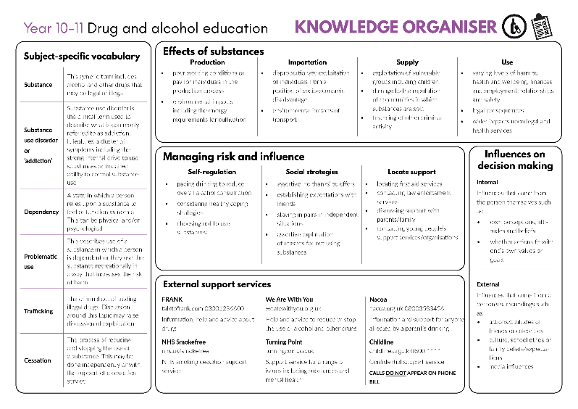
Developing subject knowledge
Teacher
slide
Key information on content related to these lessons can be found in the Year 10-11 Knowledge Organiser.
Advice on safe practice, dispelling common misconceptions, visitors to the classroom and other important information can be found in Teacher Guidance: Drug and alcohol education.
Data sources to inform your planning can be found within our document that outlines the approach of these lessons Evidence Review: Effective drug and alcohol education.
© PSHE Association 2020

Slide 6
Teacher
slide
Learning objective
To learn how to manage influences in relation to alcohol and other drug use
Learning outcomes
Students will be able to:
explain how different internal and external influences can affect decision making
describe strategies for managing peer influence in increasingly independent contexts
evaluate ways to be a positive influence on peers in relation to substance use
© PSHE Association 2020

Slide 7
Teacher
slide
Preparing to teach
Climate for learning
Make sure you have read the accompanying teacher guidance notes before teaching this lesson for guidance on establishing ground rules, the limits of confidentiality, communication and handling questions effectively.
Resources required
Box or envelope for anonymous questions
Resource 1: Influence chart [1 per pair]
Resource 2: Influence cards [1 cut-up set per pair]
Resource 3: Festival timeline [1 per pair]
Resource 3a: Festival timeline support [1 per student requiring support]
Duration
This has been designed to be taught as a sixty minute PSHE education lesson
Further guidance
Members of the PSHE Association can access our website for further guidance www.pshe-association.org.uk
60
© PSHE Association 2020

Slide 8
Teacher
slide
Lesson summary
Activity | Description | Timing
Introduction | Introduce learning objectives and outcomes and reinforce ground rules | 5 MINS
2. Baseline assessment | Students sort different influence cards onto a chart, and assess the type and level of influence for each | 10 MINS
3. Festival timeline | Pairs review a timeline of a music festival and examine the pressures and influences experienced at each stage | 15 MINS
4. Strategies | Students identify strategies for how to be a positive influence | 10 MINS
5. Influences | Groups consider how the timeline might differ without the influences identified in the previous activity | 10 MINS
6. Endpoint assessment | Students create top tips for a festival survival guide | 10 MINS
7. Signpost support | Signpost school-based and external sources of support | 5 MINS
© PSHE Association 2020

Slide 9
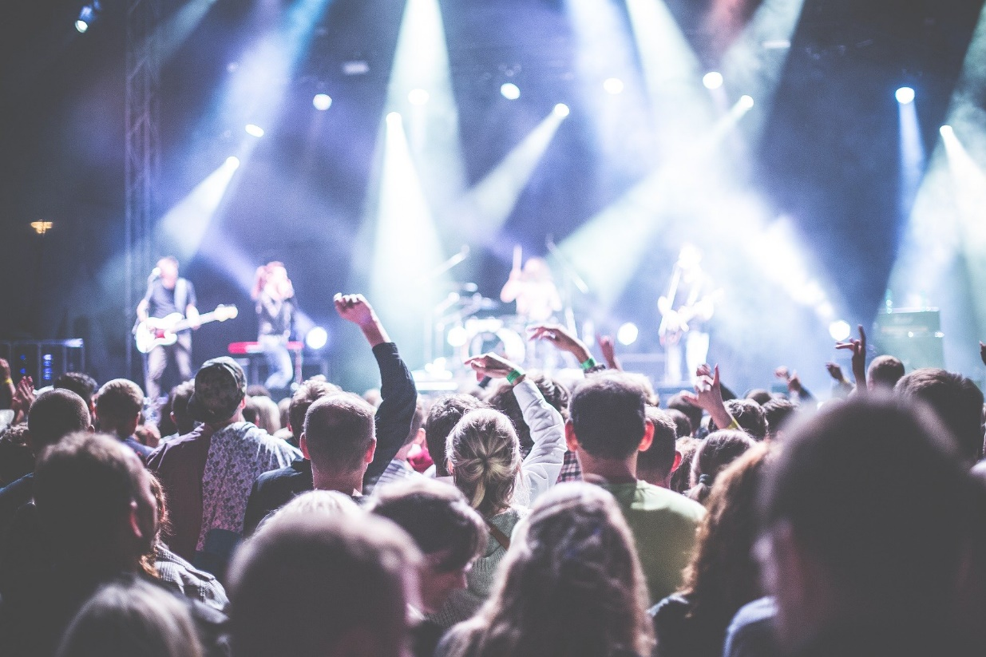
Lesson 2:
Substance use and managing influence

Slide 10
Ground rules
[Add your class rules here]
Notes:
Teacher Notes
Negotiate or revisit ground rules for the lesson. Use this slide to display your class agreement / ground rules for PSHE education lessons. See Accompanying Teacher Guidance Notes (separate document).

Slide 11
We are learning how to manage influences in relation to alcohol and other drug use
We will be able to:
explain how different internal and external influences can affect decision making
describe strategies for managing peer influence in increasingly independent contexts
evaluate ways to be a positive influence on peers in relation to substance use
Notes:
Teacher Notes – Learning objective and outcomes
Introduce the learning objective and outcomes and explain that today’s lesson explores how to manage influences in relation to substance use.

Slide 12
Influence chart
Peer group
Media, including advertising
Personal values and goals
Family
Political opinions
School ethos
Desire to fit in
Religion
Self-worth
Celebrities
Sort the influence cards onto the influence chart, assessing whether you think each is an internal or external influence and how weak or strong the impact of the influence is likely to be on a person’s behaviour.
Internal influence – relates to our own thoughts, feelings, perceptions and attitudes etc.
External influence – relates to other aspects which affect our ideas, such as those coming from others, the media, or the environment around us.
Notes:
Teacher Notes - Baseline assessment (10 mins)
In pairs, ask students to sort the influence cards from Resource 2: Influence cards (also listed above) onto Resource 1: Influence chart, assessing whether they think each is an internal or external influence and how weak or strong the impact of the influence is likely to be on a person’s behaviour. Explain to students that internal influence relates to our own thoughts, feelings, perceptions and attitudes etc., while external influence relates to other aspects which affect our ideas, such as those coming from others, the media, or the environment around us.
Next, share their responses as a class. Draw out common ideas about influences and what influences they believe have the strongest impact on behaviour. Note that there may be considerable differences in how strong an impact individual students consider an influence will have on someone’s behaviour. Religion, for example, may be identified as a very strong influence for some but not at all for others. Use the discussions from this activity to gauge students’ understanding/perception of influences relating to the use of alcohol and other drugs . Use this to prioritise and adapt discussions in the lesson.
Slight ‘ideas’ overkill in this section.
Is this better? This activity isn’t really about social norms. Maybe a copy and paste error we didn’t spot?
Challenge: Ask students if there are any other types of influence they think are common for young people that are not mentioned on the cards?

Slide 13
Festival timeline
Read the timeline of Max’s experience of preparing for and going to a festival.
In pairs, identify the potential influences on Max and the other characters at each stage, and analyse the potential impact of acting based on these pressures and influences.
Are the influences on Max internal or external, i.e. are they coming from Max himself or from an outside source?
Notes:
Teacher Notes – Festival timeline (15 mins)
As a class, read the timeline of Max’s experience of preparing for and going to a festival in Resource 3: Festival timeline.
In pairs, ask students to identify the potential influences on Max and the other characters at each stage, and analyse the potential impact of acting based on these pressures and influences.
Finally, ask students to state whether the influences on Max at each stage are internal or external, i.e. are they coming from Max himself or from an outside source?
Key learning:
At the start of the timeline, it is likely that Max is excited about going away with his friends, although he may start to feel external pressure to engage in alcohol/drug-taking activity when he receives the group messages about drugs and alcohol. While he may be going to the festival because he wants to (internal), the assumption of his friends might be that they will all be using drugs/alcohol (and Max may not want to).
At stage 2, Max may be feeling happy and relaxed and perhaps less obvious pressure to participate in taking drugs/alcohol, as there is a positive, relaxed vibe. He may feel internal influence to join in as the atmosphere is friendly and may feel safe, but external influence to join in from his friends and others attending the festival, this could be because he wants to “fit in” or feels that he is expected to.
Stage 3 of the timeline may begin with an excited and energetic mood, but Max may soon be feeling external pressure from friends and other festival goers to engage in drinking or drug-taking. They may also feel some external influence from musicians/celebrities.
At stage 4, Max may be feeling pressure to ‘stay quiet’ in case he ruins the ‘good mood’ of the others – this might be internal or external. The use of nitrous oxide (identified in the story as ‘balloons’ but also known as ‘Noz’, ‘Nos’ or ‘laughing gas’) has become more prevalent amongst young people, but can be dangerous with heavy use or unsafe inhalation practices and result in effects such as headaches, breathing problems, nerve damage, unconsciousness.
To sum up, explain that if a person can identify an influence as external, they may have a greater opportunity to evaluate whether it benefits them to act on it or not. If they recognise that the pressure is only coming from within themselves, then this can help them to resist the pressure and make more autonomous and authentic choices.
Support: Ask students to identify the influence at each stage and whether it is internal or external, using the timeline in Resource 3a: Alternative timeline
Challenge: Ask students to discuss what they think most often has the greatest impact: external or internal influence? Are there any contexts in which this balance changes?

Slide 14
Strategies
In your group, identify opportunities for Max to be a positive influence on others in the timeline, and explain what strategy he could use.
E.g. could he encourage his friend to drink water between alcoholic drinks? Should he find help or a first aid tent at any point?
Notes:
Teacher Notes – Strategies (10 mins)
Remind students that sometimes people might be going along with others because of the influences we have been considering, but it can just take one person to ‘break ranks’ for others to admit they feel the same about what is happening.
In their groups, ask students to identify opportunities for Max to be a positive influence on others in the timeline, and what strategy he could use e.g. could he encourage the friend to drink water between alcoholic drinks? Should he find help or a first aid tent at any point?
Then, ask for at least one strategy from each group. You may wish to collate these strategies on a whole class mind map.
Key learning:
In increasingly independent situations, it is important that students know how to help keep themselves and others safe. For many students, festivals or similar weekends away will be the first time they feel independent and this can be a very exciting time. It is easy for young people to get caught up ‘in the moment’, especially when with their peers and in a place where there is less direct adult supervision
It is important that young people know that they have options and that using substances or drinking alcohol is not the norm, even if it feels like it is in environments such as music festivals
Strategies might include: establishing expectations with friends before going to the festival, saying a polite but assertive ‘no thanks’ to offers of alcohol or other drugs, agreeing to respect others’ decisions not to use substances, drinking water between alcoholic drinks, arranging designated meeting points or meeting times in case they lose one another, finding appropriate help such as accessing the first aid tent if needed, always staying in at least pairs throughout the weekend.
Challenge: Ask students to discuss if they think festival organisers should do more to keep young people safe and if so, how?

Slide 15
Influences
Reflecting on who or what is influencing Max and his friends, rewrite the stage of the timeline you have been assigned.
Consider what decisions might have been made if the pressures/ influences (internal or external) had been ignored or challenged.
Notes:
Teacher Notes – Influences (10 mins)
Reflecting on who or what is influencing Max and his friends at each stage, assign groups a different part of the story each and ask them to rewrite that stage, considering what decisions might have been made if the pressures/influences (internal or external) had been ignored or challenged.
Ask each group to feedback their part of the story in order of the timeline.
Elements of the timeline that may have been different include:
The group deciding not to take alcohol or other drugs with them to the festival (e.g. if somebody spoke out against doing so at the start)
The group sticking together, returning together and creating a plan for the day together, without the use of drugs or alcohol
Telling others in the group how they are feeling about what is happening
Contacting a first aider if concerned about a friend

Slide 16
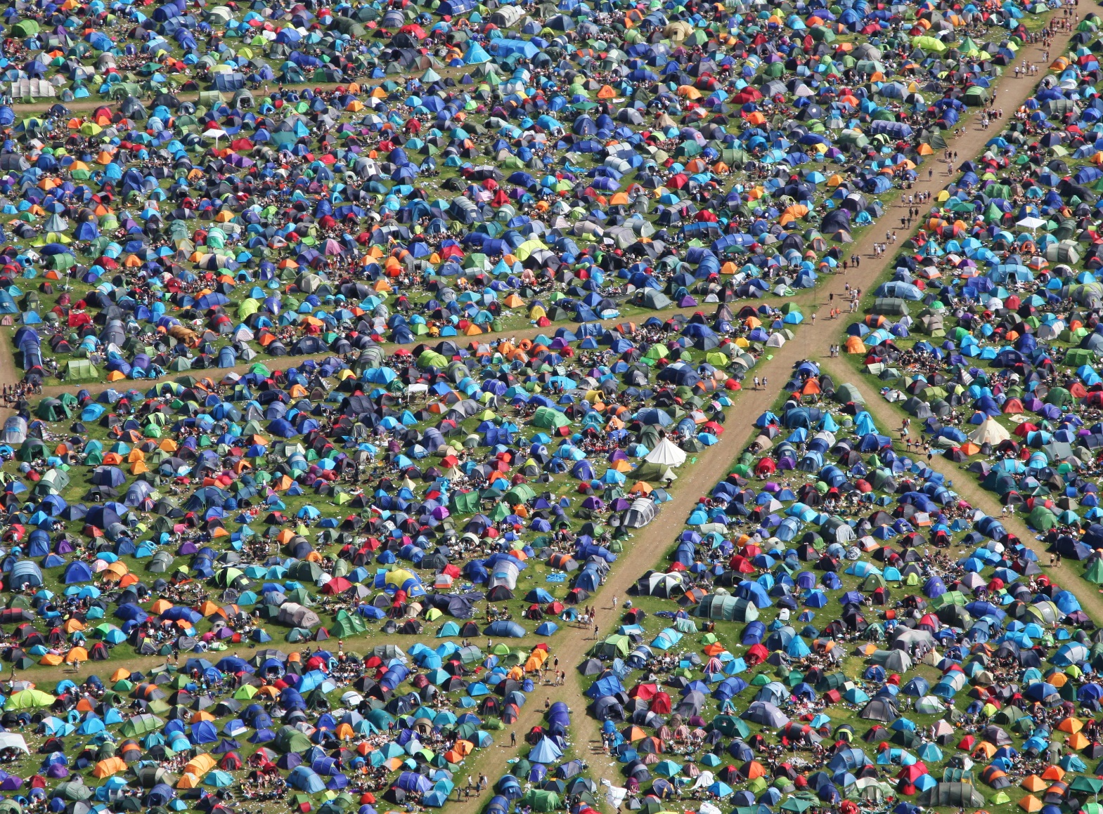
What has been learnt?
Create a list of 5 top tips for a ‘festival survival guide’ on a website, about how to keep the experience enjoyable and safe for all.
E.g. create a system to check on one another at various points in the day.
Notes:
Teacher Notes – End-point assessment (10 mins)
Ask students to come up with a list of five top tips for a ‘festival survival guide’ on a website about how to keep the experience enjoyable and safe for all, e.g. create a system to check on one another at various points in the day, aim to drink a certain amount of water to stay hydrated etc.
Students feedback what they think is their most important tip from their list. This is an opportunity for you to gather evidence of the learning that has taken place and to inform your planning for subsequent learning.

Slide 17
Further support
Speak to a tutor, head of year or other trusted member of staff in the school
Contact Childline www.childline.org.uk 0800 1111
Visit https://www.talktofrank.com
Notes:
Teacher Notes – Signposting support
Ensure that students know where they can seek help and further advice both now and in the future, if they are concerned about substance use, including alcohol and other drugs, or peer influence. Students wishing to seek further guidance can:
Speak to a tutor, head of year or other trusted member of staff in the school
Contact Childline www.childline.org.uk 0800 1111
Visit https://www.talktofrank.com/

Slide 18
More activities
Select a stage of the timeline and create a script/role-play, modelling how an individual could communicate their decision to challenge or ignore an influence.
Notes:
Teacher Notes – Extension activities
Ask students to select a stage of the timeline and create a script/role-play, modelling how an individual could communicate their decision to challenge or ignore an influence.

