Slide 1
Ensure you read the guidance before teaching the lesson
Teacher
slide
Drug and alcohol education
KS1
Year 1/2 Lesson 1
Keeping safe: things that go into and onto bodies
© PSHE Association 2020

Slide 2
Using this PowerPoint
Teacher
slide
The slides in this presentation are divided into two sections:
Teacher slides (purple) – provide key information regarding lesson preparation
Pupil slides (white) – provide a visual focus point for pupils during the lesson and delivery notes for teachers about the activities. Click ‘notes’ to view these.
Ensure that you select ‘Use Presenter View’ under the ‘Slide Show’ tab – this will allow you to preview the teaching notes on your monitor while the main presentation is displayed on a screen/smartboard.
© PSHE Association 2020

Slide 3
Challenge and support
Teacher
slide
The lesson includes suggestions for challenge and support activities, to help you differentiate appropriately for your class.
Challenge activities deepen and extend the learning for those who need more challenge or who finish the activity quickly.
Support activities are adapted to be more accessible for those who need it.
Look for the logo on the pupil slides. See delivery notes for details of the activities.
Support
Challenge
© PSHE Association 2020

Slide 4
Context
Teacher
slide
The first of three lessons for key stage 1 pupils, this lesson provides an age-appropriate introduction to drug and alcohol education. Pupils learn about different things that go into bodies and onto skin, and explore how to manage risk in relation to household products and medicines.
Neither this, nor any of the other lessons, is designed to be taught in isolation, but should always form part of a planned, developmental PSHE education programme.
© PSHE Association 2020

Slide 5
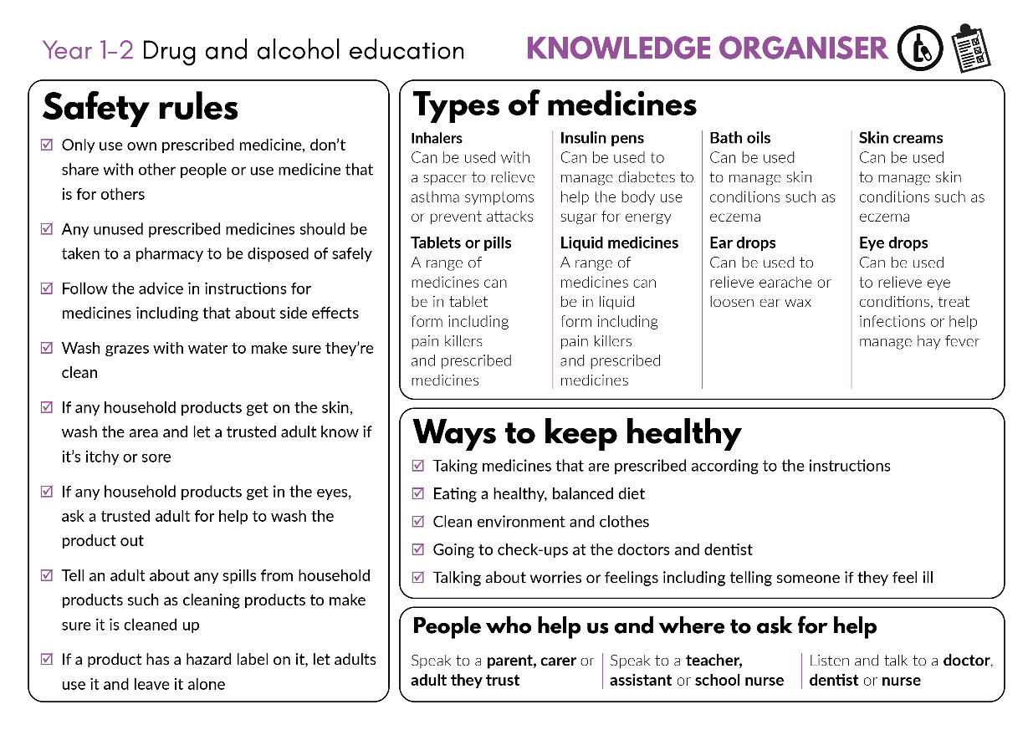
Developing subject knowledge
Teacher
slide
Key information on content related to these lessons can be found in the Year 1-2 Knowledge Organiser.
Advice on safe practice, dispelling common misconceptions, visitors to the classroom and other important information can be found in Teacher Guidance: Drug and alcohol education
Data sources to inform your planning can be found within our document that outlines the approach of these lessons Evidence Review: Effective drug and alcohol education, along with advice regarding how to talk to young people about addiction, dependency and problematic substance use.
© PSHE Association 2020

Slide 6
Teacher
slide
Learning objective
To learn about things that go into bodies or onto skin and how this can make people feel
Learning outcomes
Pupils will be able to:
describe how the things that can go into a person’s body and onto their skin can change how people look and feel
identify that some things that go into or onto bodies can be harmful (or not so good for people) and how we know if something might be harmful
suggest basic strategies to respond to situations involving household products
recognise who to ask for help with things that can go into or onto bodies
© PSHE Association 2020

Slide 7
Teacher
slide
Preparing to teach
Climate for learning
Make sure you have read the accompanying teacher guidance notes before teaching this lesson for guidance on establishing ground rules, the limits of confidentiality, communication and handling questions effectively.
Resources required
Box or envelope for anonymous questions
Resource 1: Ideas list [1 per pupil]
Resource 2: Picture cards [1 set per small group]
Resource 3: Amrit’s dilemma cards [1 card or set of cards per pair]
Resource 4: People that help us labels (1 cut set per class)
Resource 5: extension activity: Hazard labels (1 set per pair, pupil or group)
Optional: Collection of empty and washed medicine and household product bottles, containers and packets
Plastic hoops or boxes for sorting activity
Duration
This has been designed to be taught as a sixty minute PSHE education lesson
Further guidance
Members of the PSHE Association can access our website for further guidance www.pshe-association.org.uk
60
© PSHE Association 2020

Slide 8
Teacher
slide
Lesson summary
Activity | Description | Timing
1. Baseline assessment | Establish ground rules. Pupils list in two columns, things that are good for bodies and things that are not so good for bodies | 10 MINS
2. Introduction | Pupils think about what can go into or onto a person’s body - label a body outline | 5-10 MINS
3. Paired discussion | Pupils discuss how different things that go into bodies or onto skin can change how a person looks or feels | 10 MINS
4. Sorting activity | Pupils sort products into helpful/harmful and discuss how they know whether something is helpful or harmful | 10 MINS
5. Amrit’s dilemma | Pupils read a dilemma and discuss how best to manage it | 10 MINS
6. Signposting support | Pupils consider who to ask for help in different scenarios and the importance of seeking help from a trusted adult | 5 MINS
7. Plenary/end-point assessment | Pupils share one thing they have learned and add to their baseline assessment activity ideas list in the light of their new learning | 5-10 MINS
© PSHE Association 2020

Slide 9
Lesson 1
Keeping safe: things that go into and onto bodies

Slide 10
Ground rules
[Add your class rules here]
Notes:
Teacher Notes
Use this slide to display your class agreement / ground rules for PSHE education lessons. See Accompanying Teacher Guidance Notes (separate document).
Remind pupils of the ground rules for PSHE lessons and that if they have questions or are worried about things that go into or on to bodies they can write their name on a piece of paper and put in it the ask-it-basket so they can talk to the teacher later, rather than telling the whole class

Slide 11
Draw or list
Things that are good for bodies
Things that are not so good for bodies
Notes:
Teacher Notes - Baseline assessment (10 mins)
Working on their own without any discussion, using Resource 1: Ideas list ask pupils to draw and/or list:
Things that are good for bodies…
Things that are not so good for bodies
As this is a baseline assessment, it is important to use neutral, non-guiding language and avoid giving any further information until the activity has been completed. Tell pupils that it does not matter if they don’t know or are unsure about something.
Tell pupils they should not yet fill in the ‘How do you know?’ box at the bottom of the sheet, as this will be returned to at the end of the lesson

Slide 12
We are learning about things that go into bodies and onto skin and how this can make people feel
We will be able to:
say how things that go into a person’s body and onto their skin can change how people look and feel
identify that some things that go into or onto bodies can be harmful
say what to do in situations with household products
recognise who to ask for help
Notes:
Teacher Notes – Learning objective and outcomes
Introduce the learning outcomes – these are a simplified, more pupil-friendly version of the outcomes on slide 6 (teacher slide).
.

Slide 13
Introduction
What things might go into the mouth?
What might go into the nose or ears?
What things might go onto the skin?
Notes:
Teacher Notes – Introduction (5-10 mins)
Display a large body outline by drawing around a pupil on a large piece of paper and display. Draw on eyes, ears, nose, mouth. Ask pupils to think about all the different things that might go into or onto a person’s body.
Record pupils’ responses on the body outline without commenting further.
Pupil responses might include:
Things that go onto bodies: make-up, clothes, moisturiser/cream, water, tattoos, hugs/kisses, sand, jewellery, animal hair/licks, smoke, plasters, bubbles, medicines
Things that go into bodies: food, water, fizzy drinks, sweets, medicines, fresh air, insect bites, injections, smoke

Slide 14
Paired discussion
Think about the example you have been given with your partner.
How does it change how the person looks and/or feels?
Is it good or not so good for bodies?
Notes:
Teacher Notes – Paired discussion (10 mins)
Choose some examples from the annotated body outline for pupils to discuss in pairs.
Some things may be both good and not so good – notice what ideas the pupils come up with and whether pupils are able to say that this can change when there is ‘too much… or not enough’ of something.

Slide 15
Helpful or harmful card sort
Is the picture on the card helpful or harmful to bodies?
Sort the cards into two piles.
Helpful
Harmful
Notes:
Teacher Notes – Sorting activity (10 mins)
Working in small groups, pupils sort picture cards from Resource 2: Picture cards into groups according to whether the picture shown is helpful or harmful, or whether some can be both helpful or harmful to bodies. Observe pupils’ responses and discuss.
Support: Pupils select only the items they think are harmful to bodies and try to explain why.
Challenge: Extend pupils’ thinking by asking more open questions: Can they think of other examples? Can the pupils explain when or why something is helpful or harmful for the body? How do we know if something is helpful or harmful?
Bring the class back together and discuss how we know whether something could be harmful for bodies.
Teacher’s note: Empty and washed packaging could be used as the stimulus rather than picture cards for this activity, with plastic hoops or boxes used for the sorting activity.
Suggestions to support pupils’ learning:
Helpful: fresh air, water, sunscreen.
Harmful: exhaust fumes, berries from the garden may be harmful if we don’t know what they are or if they are safe to eat.
Both helpful and harmful: hygiene and cleaning products and medicines must be used safely otherwise they can be harmful; if someone eats too many sweets or drinks too much (fizzy drink) it can damage their teeth or make them feel ill; doctors and nurses use syringes to give injections that help bodies stay healthy but it is dangerous to pick up syringes if we see them lying on the ground.

Slide 16
How do we know?
How do we know whether something might be harmful for bodies or not?
The product is kept in a safe place (a high shelf or a locked cupboard)
By looking at the label
Not allowed to touch it
Can make someone poorly if they have too much

Slide 17
Amrit’s dilemma
Read the dilemma on the card:
What would help Amrit?
What would not be helpful?
Now talk to another pair who had the same card about your answers, do you agree?
Notes:
Teacher Notes – Amrit’s dilemma (10 mins)
In pairs pupils are given a card from Resource 3: Amrit’s dilemma cards. Pupils decide on the best answers to the following questions and record their responses on the card: What would help Amrit? What would not be helpful?
When completed, pupils meet with another pair who discussed the same dilemma and compare answers. Repeat with an alternative dilemma.
Support: Some scenarios are more common and require a less complex response (e.g. scenario 1, 4 and 5) and so these could be allocated to pupils requiring more support.
Challenge: Work through each of the dilemmas on the sheet individually, then compare responses with a partner.
Answers to Amrit’s dilemmas:
1. Helpful: b and avoid eating any more ice-cream / Not helpful: a and c
2. Helpful: c or parent might put medical cream on it or add medical oil to a bath / Not helpful: a and b
3. Helpful: c and not touch it / Not helpful: a and b
4. Helpful: a and adult might put anti-septic cream on it / Not helpful: b and c
5. Helpful: a and then keep eye shut for a short time / Not helpful: b (rubbing the eye worsens the effect of the shampoo) and c

Slide 18
Getting support – People who help us
Listen to one of Amrit’s dilemmas as a class. Who could help Amrit?
Stand next to the label showing the person who could help
Teacher
Doctor
Someone else
Friend
Parent
No one
Notes:
Teacher Notes – Signposting support (5 mins)
Display Resource 4. People who help us labels around the classroom.
Choose one example from Resource 3: Amrit’s dilemma cards, and ask pupils to move to stand next to the label showing the person who could help Amrit in the situation. Choose a few pupils to explain their thinking.
Draw out that it is important that they tell ‘someone’, as telling ‘no-one’ could lead to further accidents or problems. They should always talk to an adult they trust (such as a parent or teacher) if needed. Remind pupils they must never put something into their body or onto their skin if they don’t know what it is, or if they don’t have permission from their parent.

Slide 19
What has been learnt?
Share one thing you have learned about things that go into or onto bodies.
Now go back to your ideas list.
Is there anything you would like to change?
Is there anything you would like to add?
Next, add your ideas to the How do you know box at the bottom of the sheet.
Notes:
Teacher Notes – Plenary/reflecting on today’s learning and end-point assessment (5-10 mins)
Pupils share one thing they have learned about things that go into or onto bodies
Then go back to their ideas lists they made at the beginning of the lesson.
Pupils should add to or amend their list in the light of their new learning.
Pupils should also include how they know whether something is helpful or harmful to bodies by adding their ideas to the box at the bottom of the sheet – How do you know?

Slide 20
More activities
Look at the hazard labels from common household products. Can you match the hazard labels to their meanings?
Notes:
Teacher Notes – Extension activity
Pupils use Resource 5: Hazard labels individually, in pairs or small groups to match common hazard labels found on household products to their meanings and recognise why some products might be harmful to bodies.

